Slide 1
_Calm Space_
Exploring Students' Social Media Addiction:
Survey Insights Q1 2025
Mikhael Putra Iswanto
RevoU - FSDA Madrid batch JUN25
Source Collab Tableau Slide

Slide 2


_Calm Space_
Industry Model & Business Processes
An B2B SaaS EdTech company focuses on student well-being and engagement through a platform that monitors social media usage, sleep patterns, and potential conflicts. The platform also provides data-driven interventions to support mental health and academic performance.
Primary revenue comes from annual licenses offered and additional revenue through professional consulting and premium analytics packages.
> Stakeholder Analysis
Decision Maker - CEO
Consulted - Psikolog, Teacher Advisor Informed - School board, All teaching staff, students
(Approver)
Head of Data & Research
(Responsible)
Data Analyst
Data Collection
Analytics
Intervention
Reporting
Business Ops

Slide 3
_Calm Space_
Methodology
1
Defining
the problem
2
Data cleaning & preparation
3
Exploratory data analysis
4
Analysis Framework
5
Insights & recommendation
Exploratory and understand data and problem
Determine the user using DARCI
Define Objective
Data cleaning & preparation using Python
EDA using python, & tableau
Segmentation
Correlation
Summary of the remarkable insights & Recommendations

Slide 4
Objective (Root Causes Analysis)
_Calm Space_
Scope
Identify the quantitative relationship between social media usage hours and mental health outcomes, sleep duration, and frequency of social conflicts.
Segment users (students) by gender, academic, country and usage patterns to understand intervention priorities per market.
Build a simple predictive model that can estimate the risk of interpersonal conflict based on surveys.
Provide actionable recommendations for stakeholders.
The variables analyzed are limited to
Social Media Usage - Avg_Daily_Usage_Hours, Most_Used_Platform, Addicted_Score.
Well-being & Health - Sleep_Hours_Per_Night, Mental_Health_Score.
Social Interaction - Conflicts_Over_Social_Media, Relationship_Status.
Demografi - Gender, Age, Academic_Level
All data is questionnaire-based, so its validity is limited.
The data only describes a single point in time, not a cause-and-effect relationship.
The results apply to the dataset respondent population and cannot be directly generalized to all students globally.
Actionable insights are intended for school boards, teachers, and psychologists, not for clinical decisions.

Slide 5
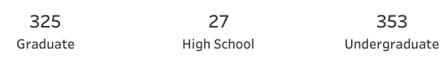

Business Problem
Hypothesis
_Calm Space_
“Within 6 months, Calm Space aims to reduce incidents of interpersonal conflict among students due to excessive social media use by 15%, by increasing average sleep quality by more than 30 minutes per night and lowering self-reported anxiety levels.”
Student who use social media more than 5 hours/day have risk of interpersonal conflict that is twice as high as student who use social media for less than 3 hours/day.
Students who sleep less than 6 hours/day tend to have anxiety/depression scores that are 25% higher than those who sleep 7 hours or more per day.
The Combination high screen time (> 5 hours/day) & short sleep (< 6 hours/day) increases risk of interpersonality conflict 2 times compared with low screen time & enough sleep.
Key Metrics (Conflict Rate, Average Sleep Duration, Screen Time Hours, Anxiety/Mental Health Score)
Total. Responden Survey

Slide 6
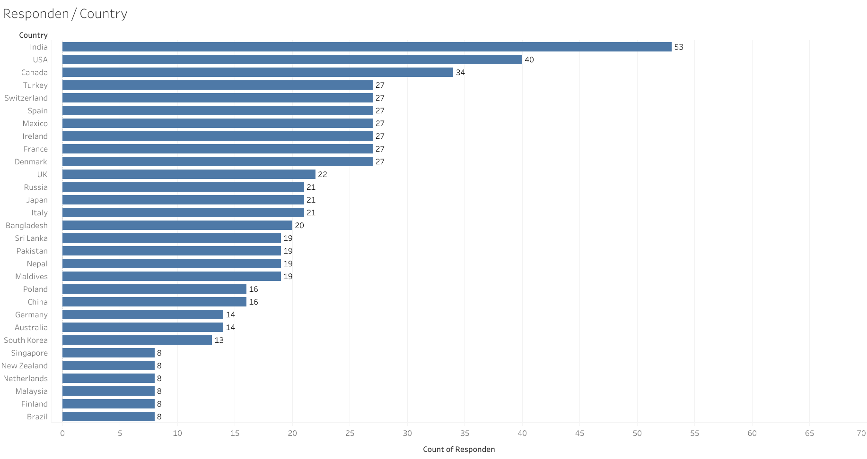
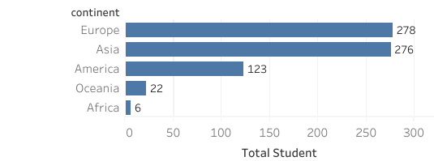
Country of Responden
The survey was conducted across five continents, but respondents were concentrated in India, the United States, and Canada, which may indicate greater access to the survey in those regions or a bias in the distribution of the survey.

Slide 7
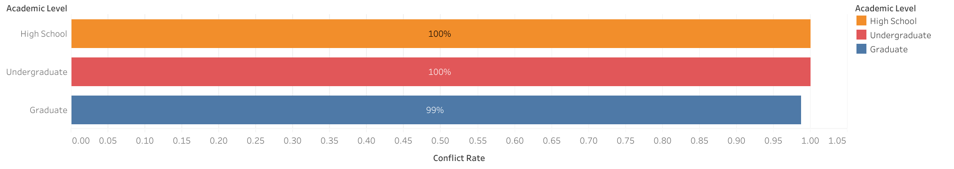
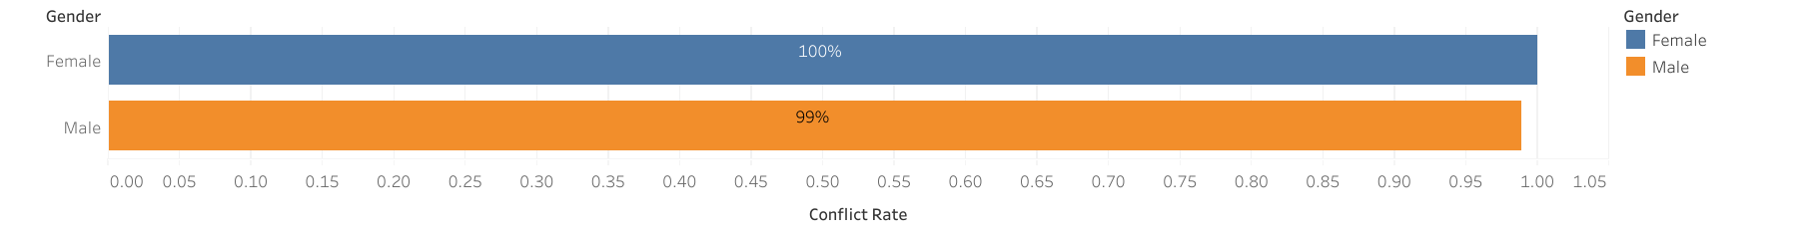


Almost All Respondents have Conflict Rate Over Social Media
Almost all respondents reported conflicts, indicating that the problem is systematic rather than individual/personal.
The level of education did not have a significant effect on reducing conflicts, although it appeared to be better at the graduate level.
The differences between genders were very small, indicating that conflicts were fairly evenly distributed and not biased towards a particular gender.

Slide 8
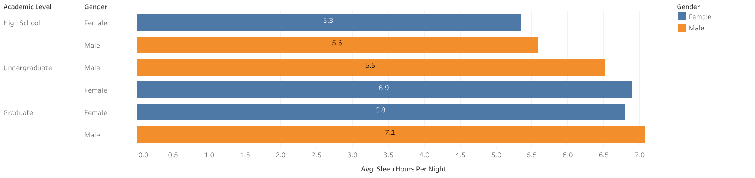

Average Sleep Duration Responden
High school students show the highest potential for sleep deprivation, sleeping less than 6 hours.
Graduate students have the highest average number of hours of sleep, with males sleeping slightly longer than females.
There is an pattern increase in hours of sleep as the level of education increases.

Slide 9
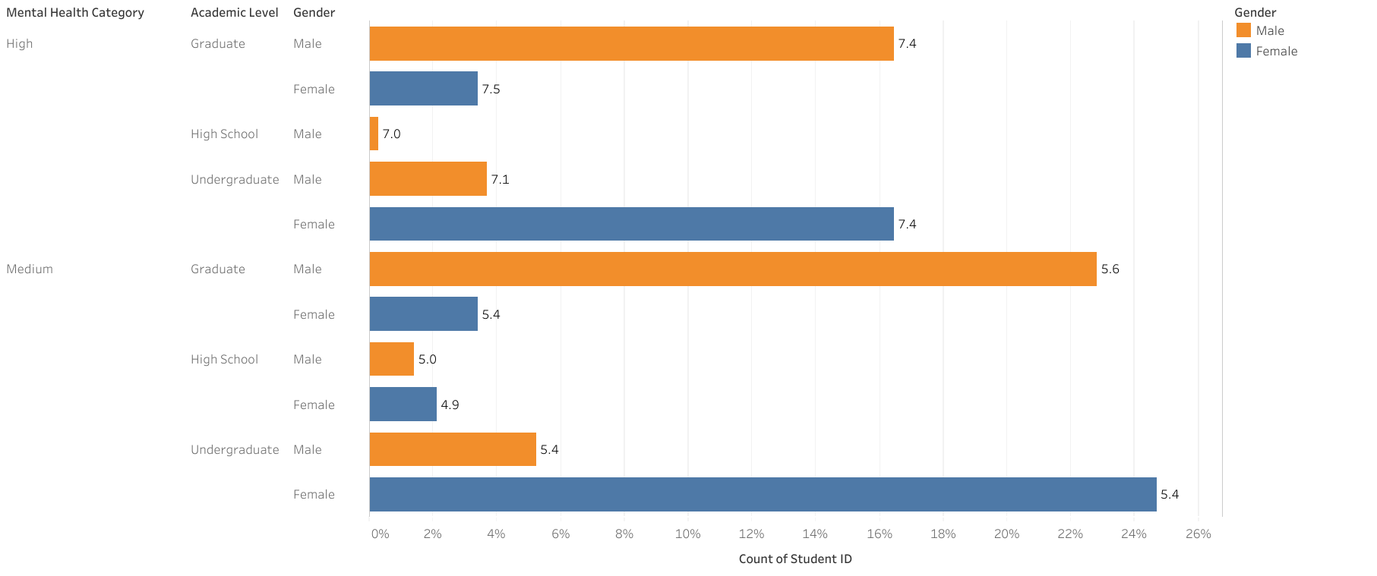
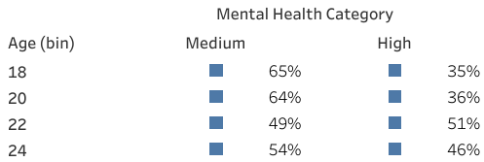


Anxiety/Mental Health Score Responden uses social media
The overall average of respondents was in the medium category (6.2).
Females tended to have higher scores in the high category than males, except at the undergraduate level.
The high anxiety category was quite dominant at all academic levels, especially at the graduate and undergraduate levels.
High school respondents were relatively fewer, but when high, they showed significant scores (7.0–7.1).
Mental health is highest at age 22 and lowest at ages 18–20.

Slide 10
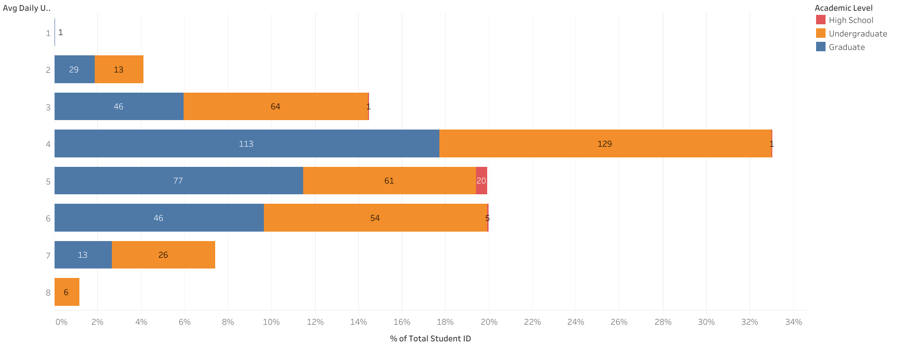


Screen Time Responden
Students dominate usage for 4-6 hours per day.
Undergraduates use social media most intensively on a daily basis, with some even reaching 8 hours per day.
Graduate students are relatively balanced (3-6 hours) and rarely exceed 7 hours per day.
High school students use social media less, but still significantly, up to 5 hours per day.
Social media usage has become a dominant daily routine rather than just an additional activity.

Slide 11
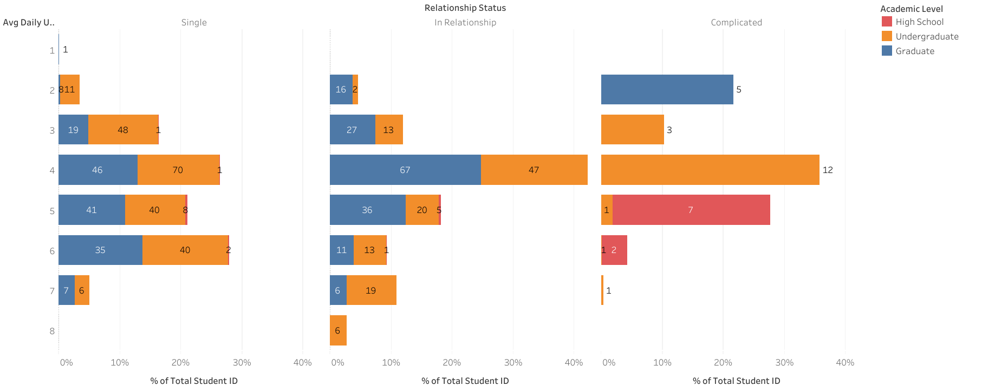
Correlation of Relationship with Screen Time Responden
Undergraduate students with a relationship status of “single” or “complicated” are at risk of excessive screen time (≥5 hours/day), which can potentially reduce mental health and productivity.
Undergraduates are the group most vulnerable to excessive screen time, not high school students.
The “complicated” relationship status triggers extreme screen time patterns, potentially impacting mental health.

Slide 12
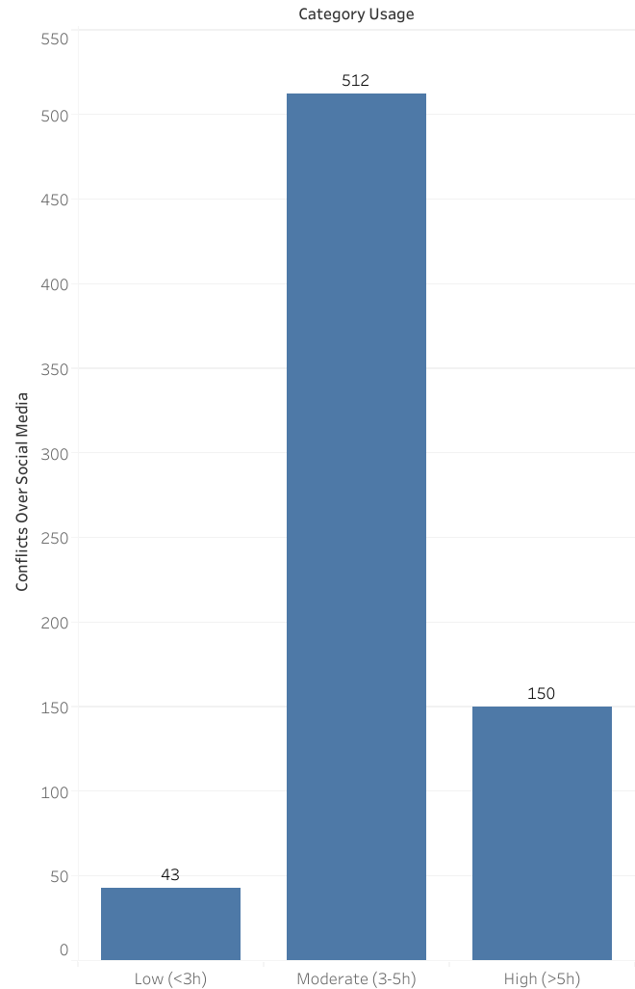
Correlation of Screen Time Responden with conflicts
> Insight
The “Moderate” zone (3–5 hours) is actually the most prone to conflict.
Conflict is not linear with screen time.
It is possible that those who are online for a very long time (>5 hours) are more “passive/observing” and therefore less involved in direct conflict, while those who are online for 3–5 hours are more actively interacting.
> Recommendation
Adakan workshop tentang etika komunikasi digital dan cara mengelola emosi saat online. Fokus pada siswa dengan screen time 3–5 jam/hari.
Dorong siswa untuk lebih banyak melakukan interaksi positif, seperti kerjasama akademi, berbagi karya, atau diskusi sehat. Tingkatkan kualitas, bukan hanya kurangi waktu layar.
Gunakan alat bantu monitoring dan refleksi.

Slide 13
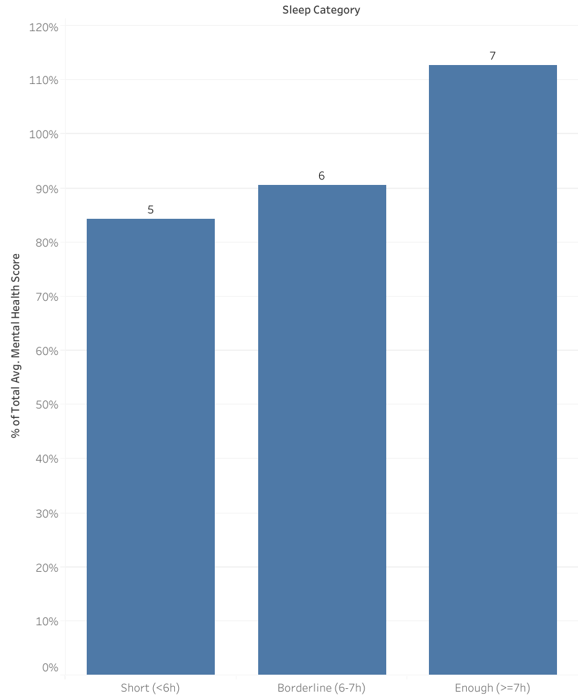
Correlation of Screen Time Responden with Mental Health
> Insight
Sleep duration is one of the key factors affecting mental health.
Consistently getting 7 hours of sleep supports a healthier psychological condition (113%).
Less than 6 hours of sleep shows the lowest health score (-85%).
> Recommendation
Education for students on factors that disrupt sleep (screen time & sleep routines)

Slide 14
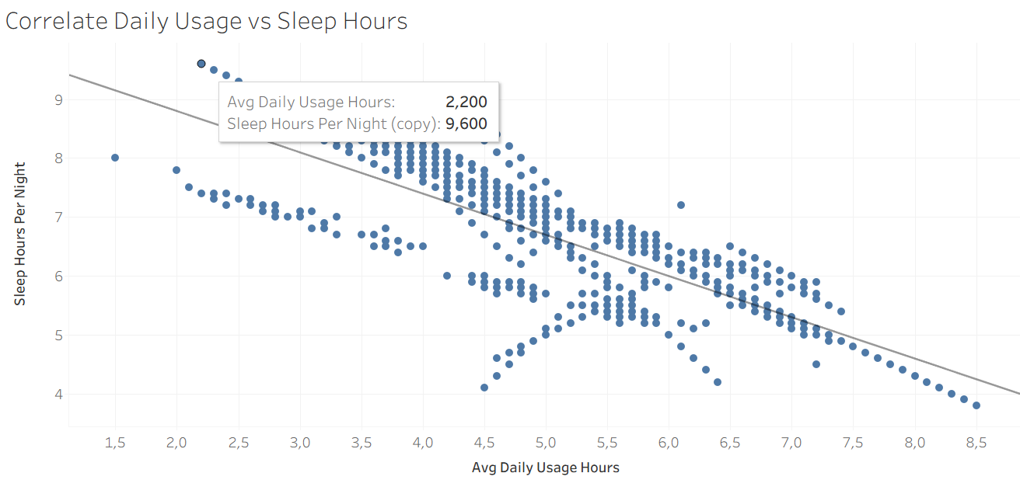
A strong negative correlation between daily usage duration and hours of sleep
The longer a person uses social media, the fewer hours of sleep they get.

Slide 15
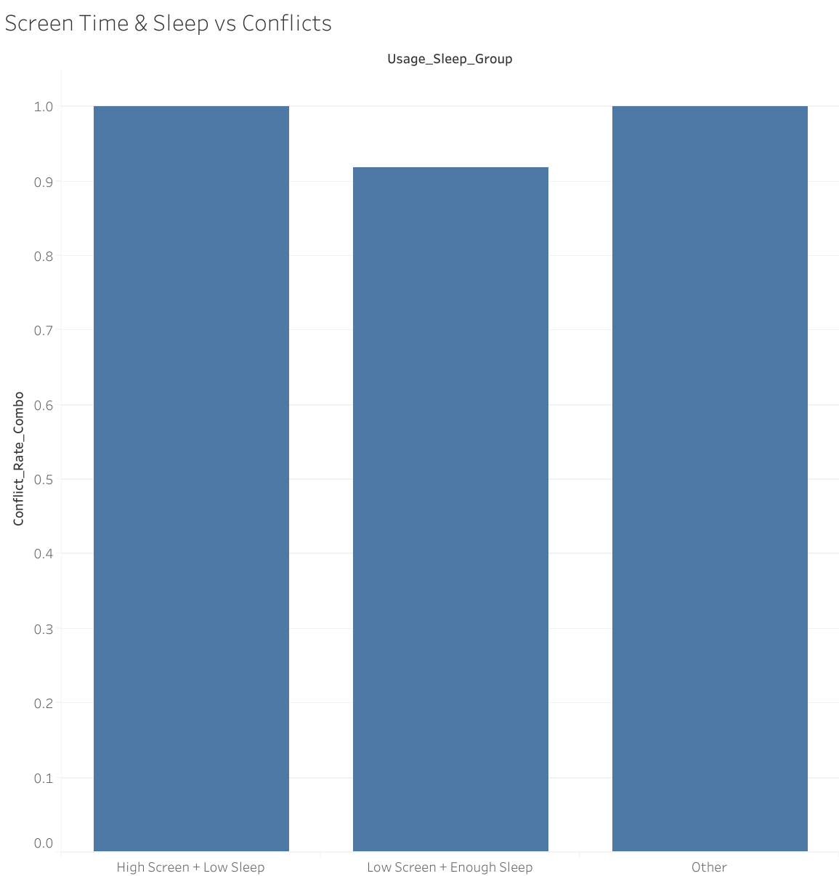
Correlation of Screen Time & Time Sleep Responden with Conflicts over Social Media
> Insight
The combination of screen use and lack of sleep contributes to conflict (score 1.0).
Low screen time and adequate sleep help reduce the potential for conflict.
Groups with inconsistent sleep/screen time patterns remain vulnerable to conflict.
> Recommendation
Educate parents and students about screen time + sleep and how to improve sleep quality and duration Reduce excessive screen time
Provide positive alternative activities

Slide 16
Summary Insight & Recommendation
_Calm Space_
Conflict are Systematic, not isolated
Strong negative correlation between screen time & sleep
Sleep is a Key Mediator, Students sleeping <6H have the lowest mental health scores (-85%)
Undergraduates, especially “single”/“complicated” status, are most vulnerable to conflict and anxiety.
Graduate students show more balance (3–6h usage, 7h sleep).
The “moderate” usage group (3–5h/day) is paradoxically most conflict-prone, possibly due to higher interaction intensity.
Focus Q2 2025 on sleep extension (+30 min avg) and screen time moderation.
Target undergraduates with “single/complicated” status as high-risk group.
Deploy gamified digital detox campaigns.
Provide institutional wellness dashboards to demonstrate progress.
Expected outcome: –15% conflict reduction, lower anxiety prevalence, and stronger Calm Space brand as a digital wellness solution in education.

Slide 17
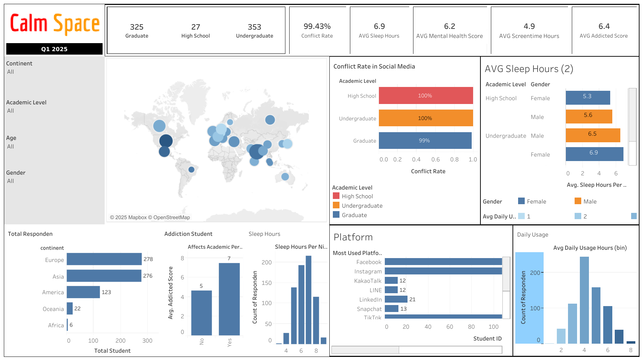
Dashboard

Slide 18
QnA

Slide 19
Thank You
Exploring Students' Social Media Addiction: Survey Insights from Q1 2025
Mikhael Putra Iswanto
RevoU - FSDA Madrid batch JUN25
Source Collab Tableau Slide

Slide 20
APPENDIX
Link Python

Slide 21
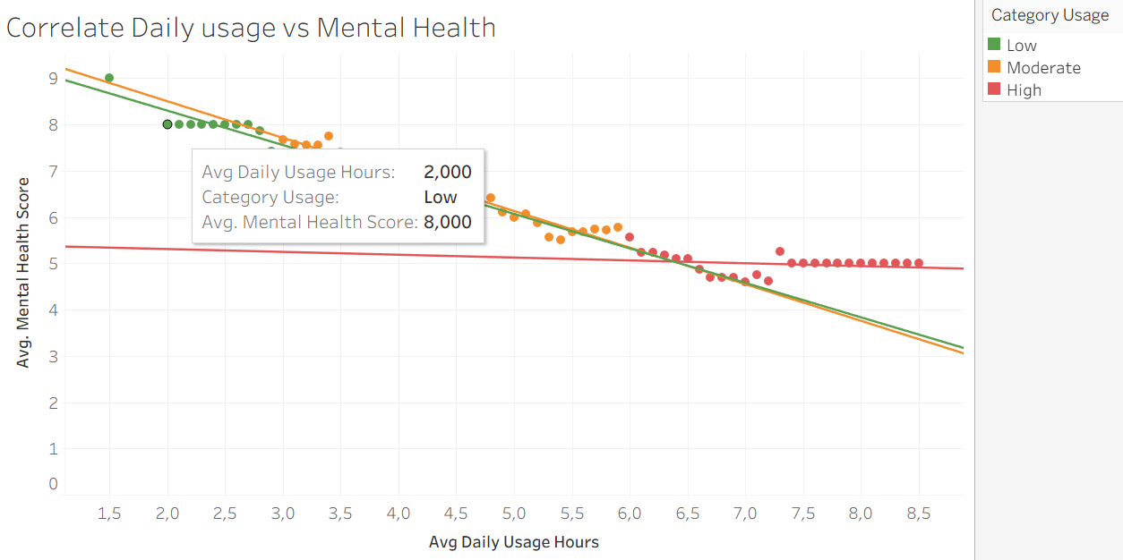
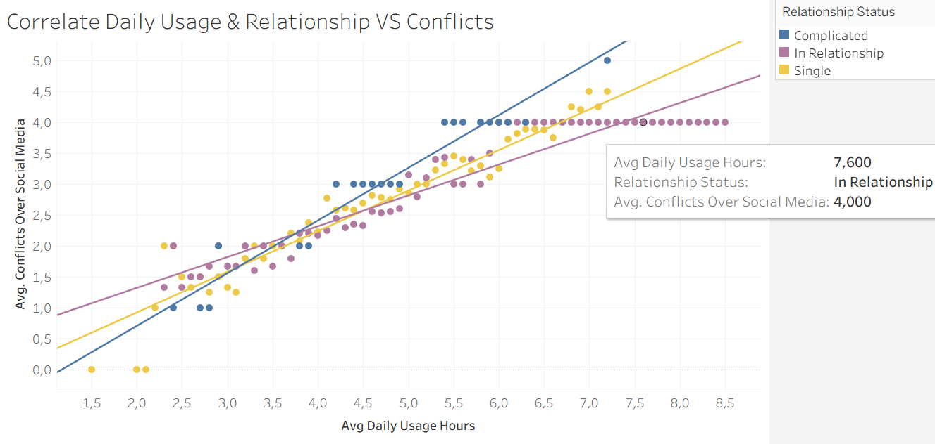
Correlation
Excessive social media use (more than 5 hours/day) is strongly correlated with poorer mental health.
The most significant impact is seen among low and moderate users, while high users are already at a low point and do not deteriorate much further.
Positive correlation: the higher the daily use of social media, the higher the conflict on social media
Relationship status is related to this correlation, with the highest conflict occurring among those with a “Complicated” status, followed by “Single,” and the lowest among those “in a relationship”.

Slide 22
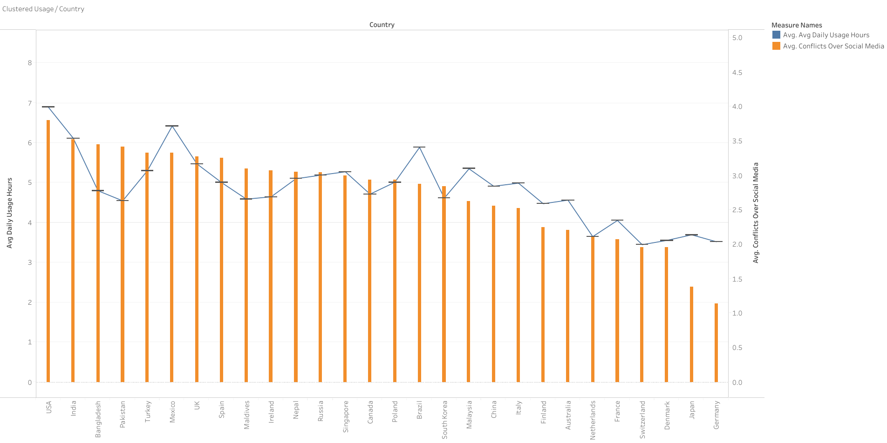
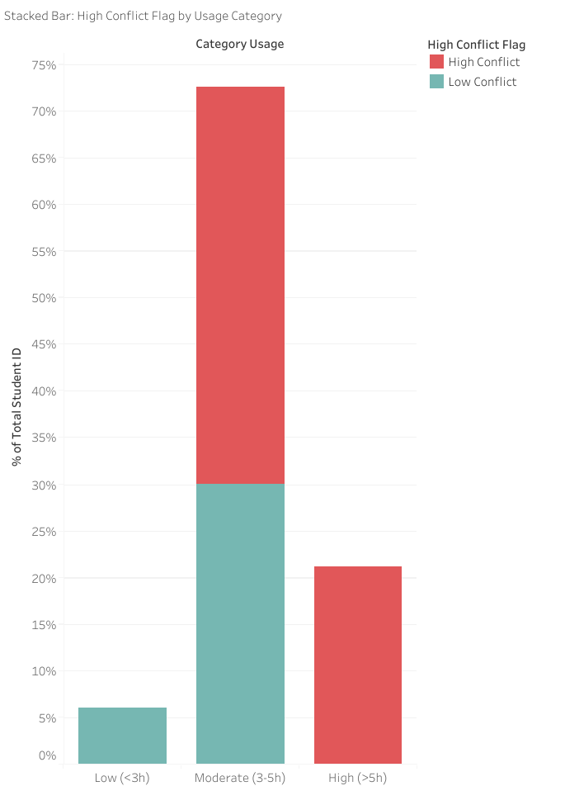
Results Average Daily Usage per Country
The USA and India have the highest daily social media usage (>6 hours/day), but high usage does not always correlate linearly with conflict.
For example, Bangladesh and Pakistan have relatively lower usage hours than the USA, but the resulting conflict is quite high.
The majority of interactions on social media trigger high conflict (>3). This indicates a high potential for negative impacts on mental health, especially in countries with high usage hours.
The higher the usage, the higher the conflicts
The majority of respondents were not low users, but moderate/high users, and more than half had been affected by the conflict.

Slide 23
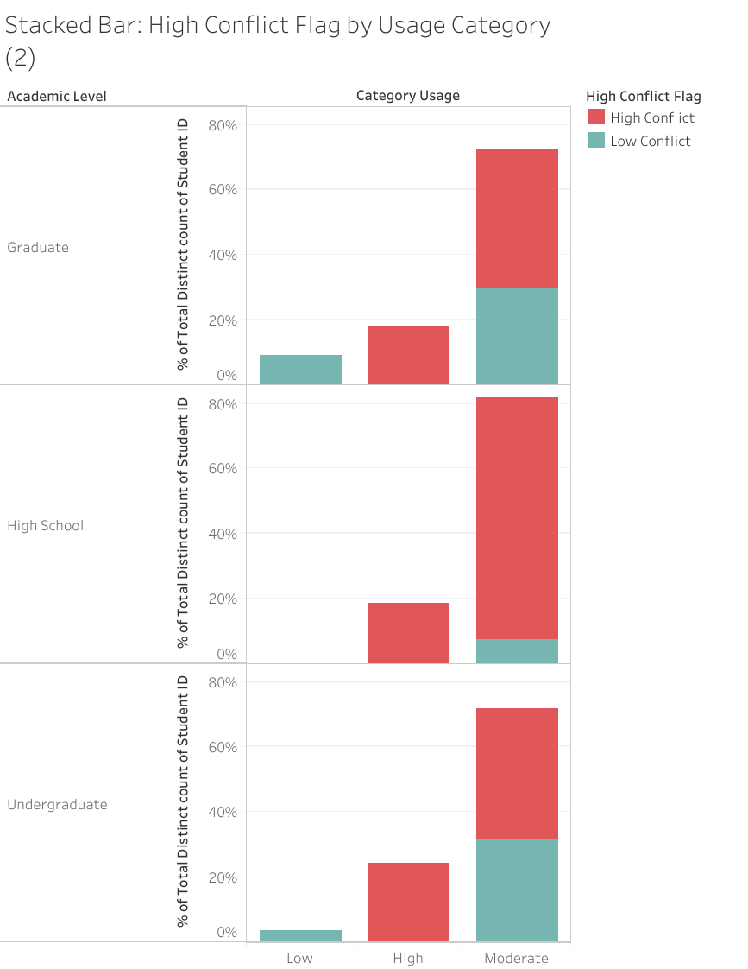
Results by Academic Level
In the first quarter, social media addiction among university and high school students was high and led to social conflicts
High school students were the respondents most affected by high conflict, even at moderate usage levels.
Undergraduate conflict was high at high usage levels, but more balanced at moderate usage levels.
Graduate conflict was still significant, but more controlled than at the high school level.

